Slide 1
Decision-tree Learning*
Damian A. Tamburri, Ph.D.
* Some slides courtesy of My course at JADS and CMU-ML 2013-2014 & T. Mitchell.

Slide 2
What will you learn today?
How does decision-tree learning work?
When should I use it?
How can I avoid its limitations?
Where are the business rules that DT extracts?

Slide 3
What have we seen so far…
Unsupervised ML that features Inductive logic
«the premises are viewed as supplying some evidence for the truth of the conclusion»*
* Copi, I. M.; Cohen, C.; Flage, D. E. (2006). Essentials of Logic (Second ed.). Upper Saddle River, NJ: Pearson Education. ISBN 978-0-13-238034-8.

Slide 4
What have we seen so far…
Unsupervised ML that features Inductive logic
«the premises are viewed as supplying some evidence for the truth of the conclusion»*
Data features!
* Copi, I. M.; Cohen, C.; Flage, D. E. (2006). Essentials of Logic (Second ed.). Upper Saddle River, NJ: Pearson Education. ISBN 978-0-13-238034-8.

Slide 5
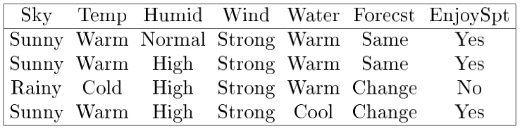
Suppose you want to learn something from this dataset...

Slide 6
Suppose you want to learn something from this dataset...
What if I told you that learning means “searching”?
And searching takes place with a strategy?
And the goal should be to improve the strategy’s effectiveness over time?

Slide 7
Suppose you want to learn something from this dataset...
What if I told you that learning means “searching”?
And searching takes place with a strategy?
And the goal should be to improve the strategy’s effectiveness over time?
Let’s go step by step...

Slide 8
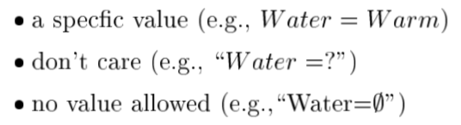
There are many possible hypotheses...
In our previous dataset, a hypotheses is a conjunction of constraints (imposed values) over attributes (“columns” over dataset), e.g.:
< sunny, - , - , strong, - , same >
Possible Constraints

Slide 9
There are many possible hypotheses...
In our previous dataset, a hypotheses is a conjunction of constraints (imposed values) over attributes (“columns” over dataset), e.g.:
< ?, - , - , ?, - , ? >
Possible Constraints

Slide 10
There are many possible hypotheses...
In our previous dataset, a hypotheses is a conjunction of constraints (imposed values) over attributes (“columns” over dataset), e.g.:
< ?, ? , ? , ?, ? , ? >
Possible Constraints

Slide 11
There are many possible hypotheses...
In our previous dataset, a hypotheses is a conjunction of constraints (imposed values) over attributes (“columns” over dataset), e.g.:
< ,  ,  , ,  , >
Is this a hypothesis?
Possible Constraints

Slide 12
There are many possible hypotheses...
In our previous dataset, a hypotheses is a conjunction of constraints (imposed values) over attributes (“columns” over dataset), e.g.:
< ,  ,  , ,  , >
Yes... It is a *most-specific* hypothesis
Possible Constraints

Slide 13
Classification is Concept Learning!
Concept learning, given a series of attribute values learn to predict whether a corresponding concept is true or not, for example, given this new input:
< sunny, - , - , strong, - , same >
Predict whether the day is good to “EnjoySport”

Slide 14
Suppose you want to learn something from this dataset...
Conclusion!
Variables!

Slide 15
Training Examples
Are positive and negative examples of a classification function:
Variables tuple!
classification

Slide 16
Inductive Learning Hypothesis
Inductive Learning.
“Any hypothesis H found to approximate the target function C over a sufficiently large dataset D of training examples, will also approximate the target function well over unknown or unobserved examples D_{u} ”

Slide 17
What have we seen so far: for example…
Unsupervised ML that features Inductive logic
«the premises are viewed as supplying some evidence for the truth of the conclusion»
KNN ➔ uses geometrical premises in the data to induce clusters

Slide 18
What have we seen so far: for example…
Unsupervised ML that features Inductive logic
«the premises are viewed as supplying some evidence for the truth of the conclusion»
KNN ➔ uses geometrical premises in the data to induce clusters
Regression ➔ uses proximity modelling and functional isomorphisms to induce an approximate function to all dataset
…

Slide 19
So…
What if we take the opposite approach?
DEDUCTIVE REASONING

Slide 20
Deductive Reasoning!
Deductive reasoning*. “logical deduction is the process of reasoning from one or more statements (premises) to reach a logically certain conclusion.”
Deductive reasoning... Why do you think a game of 20 questions works?
20 Questions:
“is a spoken parlor game which encourages deductive reasoning and creativity.” Cit. [Wikipedia]
Within 20-question space, deduce nature of subject with YES/NO answers only
* also deductive logic

Slide 21
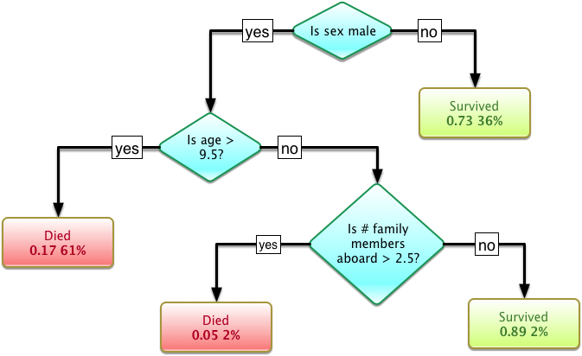
Deductive Reasoning 101
YES/NO means classification by exclusion of basic conditions, for example:

Slide 22
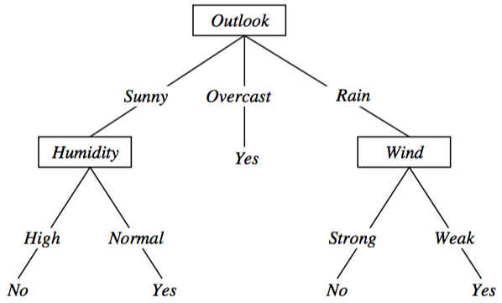
Decision-Tree for PlayTennis

Slide 23
Decision-Tree for PlayTennis
Attributes to be tested

Slide 24
Decision-Tree for PlayTennis
Possible values
Attributes to be tested

Slide 25
Decision-Tree for PlayTennis
Possible values
Attributes to be tested
Final response (classification)

Slide 26
When do we use Decision-Trees?
Possible values
????
Attributes to be tested
Final response (classification)

Slide 27
When do we use Decision-Trees?
Possible values
Attributes to be tested
1. Instances are expressible as (attribute,value) pairs;

Slide 28
When do we use Decision-Trees?
Possible values
Attributes to be tested
2. Disjunctive hypotheses are required;

Slide 29
How does decision-tree learning actually take place?
Suppose the following algorithm:
A ← “best” decision attribute for next node in decTree;
<<decTree>>
A

Slide 30
How does decision-tree learning actually take place?
Suppose the following algorithm:
A ← “best” decision attribute for next node in decTree;
Forall values of attribute A, create new descendant node:
<<decTree>>
A
v1
v3
v2

Slide 31
How does decision-tree learning actually take place?
Suppose the following algorithm:
A ← “best” decision attribute for next node in decTree;
Forall values of attribute A, create new descendant node:
<<decTree>>
A
v1
v3
3. Sort rest of training examples with respect to leaves of A
v2

Slide 32
How does decision-tree learning actually take place?
Suppose the following algorithm:
A ← “best” decision attribute for next node in decTree;
Forall values of attribute A, create new descendant node:
<<decTree>>
A
v1
v3
4. Are all training examples classified?
v2

Slide 33
How does decision-tree learning actually take place?
Suppose the following algorithm:
A ← “best” decision attribute for next node in decTree;
Forall values of attribute A, create new descendant node:
<<decTree>>
A
v1
v3
5. YES ➔ STOP!
v2

Slide 34
How does decision-tree learning actually take place?
Suppose the following algorithm:
A ← “best” decision attribute for next node in decTree;
Forall values of attribute A, create new descendant node:
<<decTree>>
A
v1
v3
6. NO ➔ select a new A and continue...
v2

Slide 35

What’s wrong with the algorithm?
Guess...
A ← “best” decision attribute for next node in decTree;
Forall values of attribute A, create new descendant node
3. Sort rest of training examples with respect to leaves of A
4. Are all training examples classified?

Slide 36
What’s wrong with the algorithm?
Hint: what’s wrong with the first line??
A ← “best” decision attribute for next node in decTree;
Forall values of attribute A, create new descendant node
3. Sort rest of training examples with respect to leaves of A
4. Are all training examples classified?

Slide 37

What’s wrong with the algorithm?
Allright... Here it is: How do we select the “best” A?

Slide 38
How does decision-tree learning actually take place?
Suppose the following algorithm:
A ← “best” decision attribute for next node in decTree;
<<decTree>>
A

Slide 39
Along comes a spider...
Best ➔ the Attribute which discriminates the most across all the available information;

Slide 40
Along comes a spider...
Best ➔ the Attribute with the most informative content;

Slide 41
Along comes a spider...
Best ➔ the Attribute whose information counts the most with respect to others;

Slide 42
This slide is left intentionally blank
<moment of suspense>

Slide 43
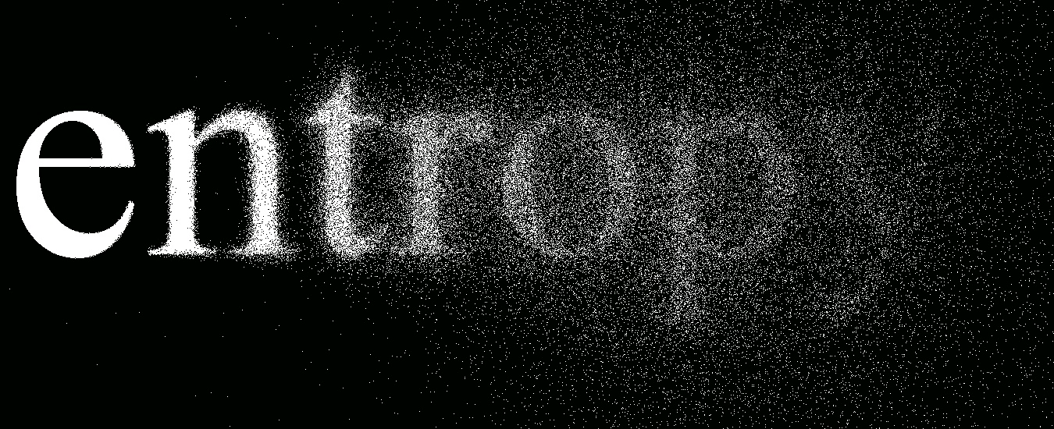
Along comes a spider...
Best ➔ The attribute which most reduces Entropy!
Entropy!

Slide 44
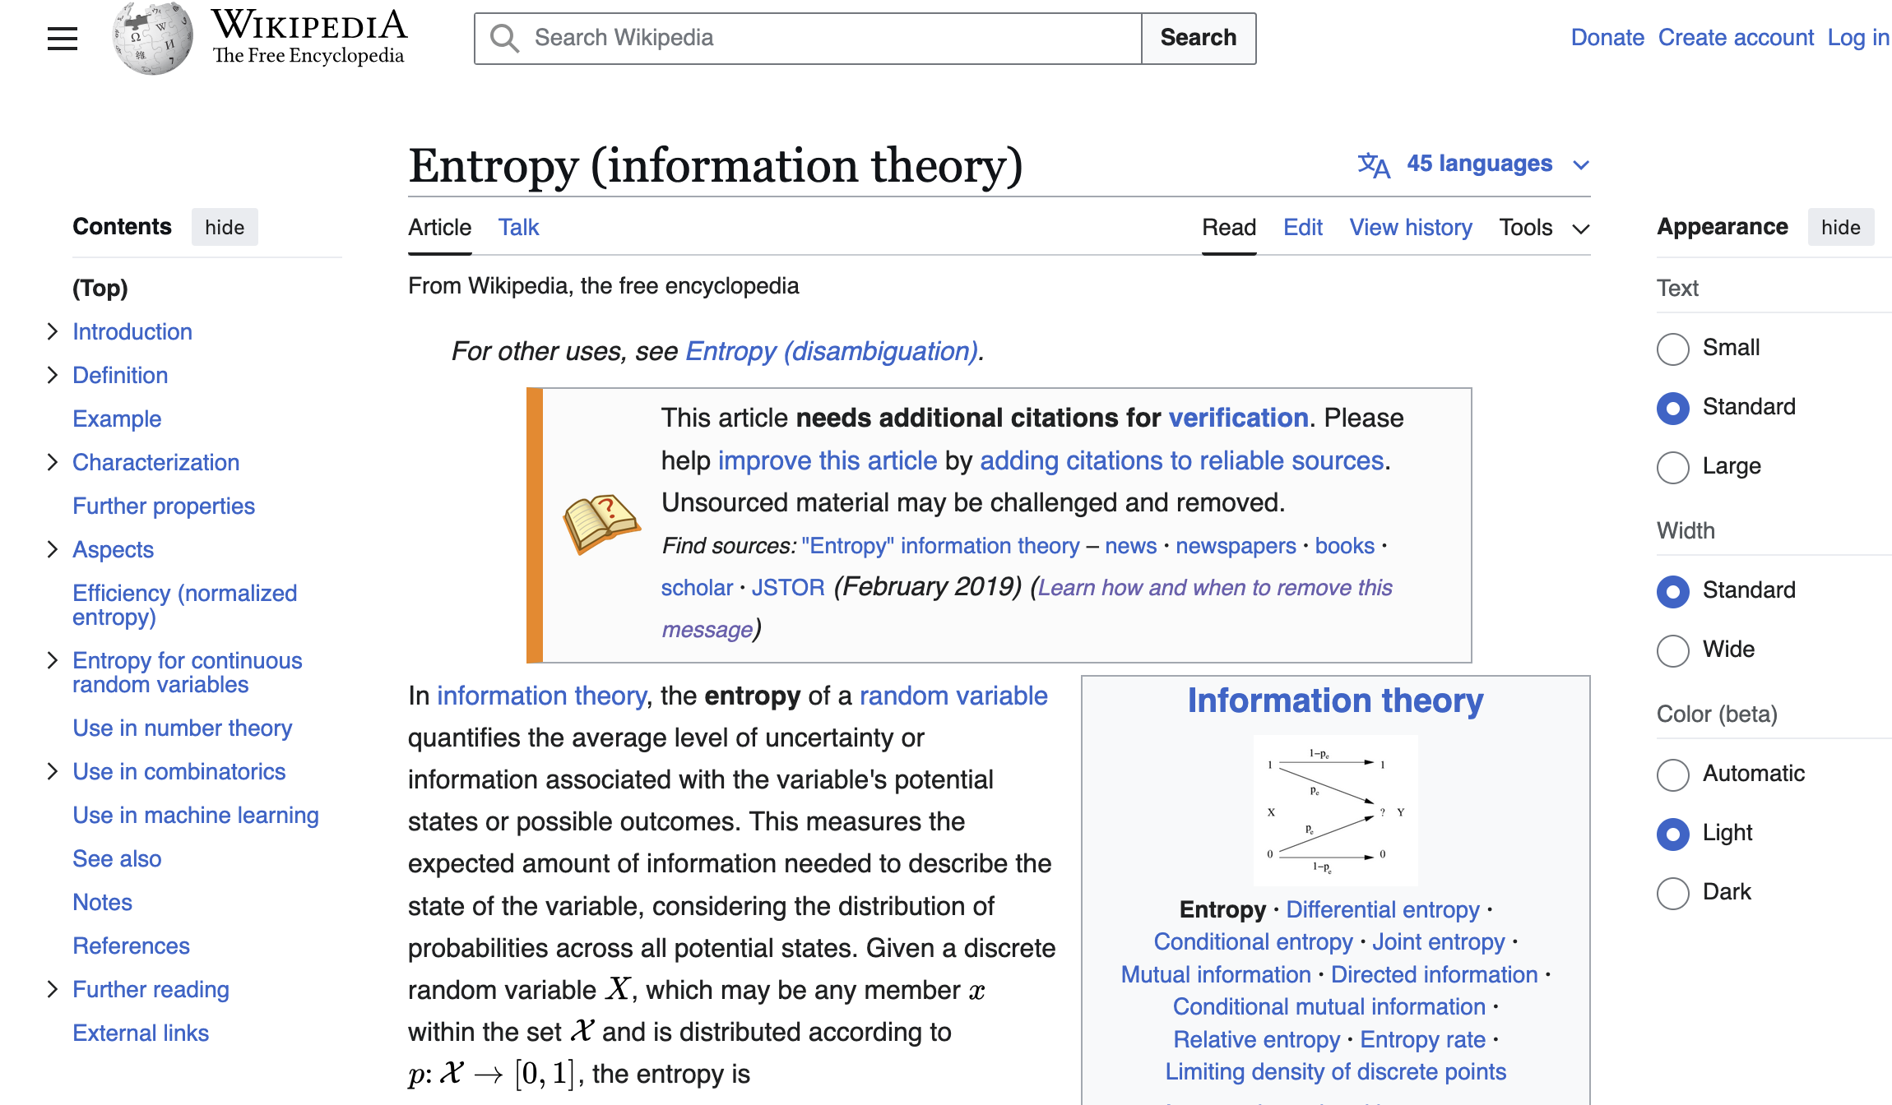

Slide 45
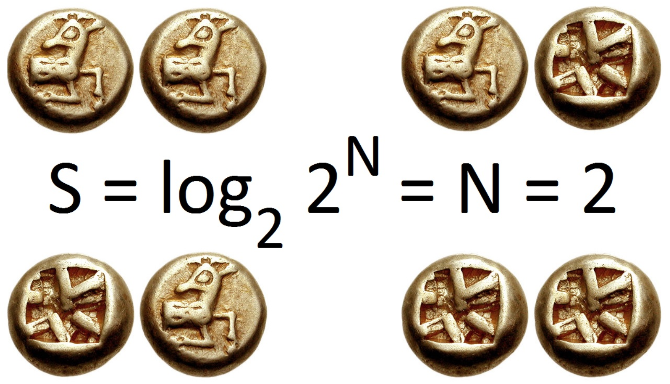
Entropy, Definition
“the average amount of information produced by a stochastic source of data”
For example...
Two fair coin tosses, I_{e} (in bits) == base-2 logarithm of the number of possible outcomes;
2 coins ➔ 4 outcomes ➔ 2 bits of entropy.
Notes:
The logarithm of the probability distribution is useful as a measure of entropy because it is additive for independent sources. For instance, the entropy of a fair coin toss is 1 bit, and the entropy of m tosses is m bits. In a straightforward representation, log₂(n) bits are needed to represent a variable that can take one of n values if n is a power of 2.
Information entropy is typically measured in bits (alternatively called "shannons”).
NOTE: In mathematics, the logarithm is the inverse operation to exponentiation, just as division is the inverse of multiplication. That means the logarithm of a number is the exponent to which another fixed number, the base, must be raised to produce that number. In the most simple case the logarithm counts repeated multiplication of the same factor; e.g., since 1000 = 10 × 10 × 10 = 10³

Slide 46
Entropy, Definition
“the average amount of information produced by a stochastic source of data”
Generally...
“...information entropy is the average amount of information conveyed by an event, when considering all possible outcomes.”

Slide 47
Entropy Demystified
Let S be a sample of training examples

Slide 48
Entropy Demystified
Let S be a sample of training examples
Let p_{Pos} be the proportion of positive examples in S with respect to attribute A

Slide 49
Entropy Demystified
Let S be a sample of training examples
Let p_{Pos} be the proportion of positive examples in S with respect to attribute A
Let p_{Neg} be the proportion of Negative examples in S with respect to attribute A

Slide 50
Entropy Demystified
Let S be a sample of training examples
Let p_{Pos} be the proportion of positive examples in S with respect to attribute A
Let p_{Neg} be the proportion of Negative examples in S with respect to attribute A
Entropy E is a measurement of the impurity of S (i.e., the density of positivity w.r.t., negativity)

Slide 51
Entropy Demystified
Let S be a sample of training examples
Let p_{Pos} be the proportion of positive examples in S with respect to attribute A
Let p_{Neg} be the proportion of Negative examples in S with respect to attribute A
Entropy E is a measurement of the impurity of S (i.e., the density of positivity w.r.t., negativity)
<moment of suspense...>

Slide 52
Entropy Demystified
Let S be a sample of training examples
Let p_{Pos} be the proportion of positive examples in S with respect to attribute A
Let p_{Neg} be the proportion of Negative examples in S with respect to attribute A
Entropy E is a measurement of the impurity of S (i.e., the density of positivity w.r.t., negativity)
E(I(S)) =E(???);
Notes:
https://en.wikipedia.org/wiki/Entropy_(information_theory)

Slide 53
Here’s what we know…
I(p) is monotonically decreasing in p
an increase in the probability of an event decreases the information from an observed event, and vice versa
I(p) ≥ 0
information is a non-negative quantity
I(1) = 0
events that always occur do not communicate information
I(p₁ p₂) = I(p₁) + I(p₂)
information due to independent events is additive
Notes:
It states that joint probability of independent sources of information communicates as much information as the two individual events separately. Particularly, if the first event can yield one of n equiprobable outcomes and another has one of m equiprobable outcomes then there are mn possible outcomes of the joint event. This means that if log₂(n) bits are needed to encode the first value and log₂(m) to encode the second, one needs log₂(mn) = log₂(m) + log₂(n) to encode both.

Slide 54
Here’s what we know…
I(p) is monotonically decreasing in p
an increase in the probability of an event decreases the information from an observed event, and vice versa
I(p) ≥ 0
information is a non-negative quantity
I(1) = 0
events that always occur do not communicate information
I(p₁ p₂) = I(p₁) + I(p₂)
information due to independent events is additive
Notes:
It states that joint probability of independent sources of information communicates as much information as the two individual events separately. Particularly, if the first event can yield one of n equiprobable outcomes and another has one of m equiprobable outcomes then there are mn possible outcomes of the joint event. This means that if log₂(n) bits are needed to encode the first value and log₂(m) to encode the second, one needs log₂(mn) = log₂(m) + log₂(n) to encode both.

Slide 55
Here’s what we know…
Joint probability of independent sources of information communicates as much information as the two individual events separately
if the first event can yield one of n equiprobable outcomes and another has one of m equiprobable outcomes then there are m*n possible outcomes of the joint event;
This means that if log₂(n) bits are needed to encode the first value and log₂(m) to encode the second, one needs log₂(mn) = log₂(m) + log₂(n) to encode both!
I(p) is monotonically decreasing in p
an increase in the probability of an event decreases the information from an observed event, and vice versa
I(p) ≥ 0
information is a non-negative quantity
I(1) = 0
events that always occur do not communicate information
I(p₁ p₂) = I(p₁) + I(p₂)
information due to independent events is additive
Notes:
It states that joint probability of independent sources of information communicates as much information as the two individual events separately. Particularly, if the first event can yield one of n equiprobable outcomes and another has one of m equiprobable outcomes then there are mn possible outcomes of the joint event. This means that if log₂(n) bits are needed to encode the first value and log₂(m) to encode the second, one needs log₂(mn) = log₂(m) + log₂(n) to encode both.

Slide 56

Lollipop Time!
Joint probability of independent sources of information communicates as much information as the two individual events separately
if the first event can yield one of n equiprobable outcomes and another has one of m equiprobable outcomes then there are m*n possible outcomes of the joint event;
This means that if log₂(n) bits are needed to encode the first value and log₂(m) to encode the second, one needs log₂(mn) = log₂(m) + log₂(n) to encode both!
I(p) is monotonically decreasing in p
an increase in the probability of an event decreases the information from an observed event, and vice versa
I(p) ≥ 0
information is a non-negative quantity
I(1) = 0
events that always occur do not communicate information
I(p₁ p₂) = I(p₁) + I(p₂)
information due to independent events is additive
So… what is the proper function to encode the above properties?
Notes:
It states that joint probability of independent sources of information communicates as much information as the two individual events separately. Particularly, if the first event can yield one of n equiprobable outcomes and another has one of m equiprobable outcomes then there are mn possible outcomes of the joint event. This means that if log₂(n) bits are needed to encode the first value and log₂(m) to encode the second, one needs log₂(mn) = log₂(m) + log₂(n) to encode both.

Slide 57
Entropy Demystified
Let S be a sample of training examples
Let p_{Pos} be the proportion of positive examples in S with respect to attribute A
Let p_{Neg} be the proportion of Negative examples in S with respect to attribute A
Entropy E is a measurement of the impurity of S (i.e., the density of positivity w.r.t., negativity)
That’s right. The Logarithmical Function!
E(I(S)) =E( log(1/P(S)) );
Notes:
https://en.wikipedia.org/wiki/Entropy_(information_theory)

Slide 58
Entropy Demystified
Let S be a sample of training examples
Let p_{Pos} be the proportion of positive examples in S with respect to attribute A
Let p_{Neg} be the proportion of Negative examples in S with respect to attribute A
Entropy E is a measurement of the impurity of S (i.e., the density of positivity w.r.t., negativity)
And, by the properties of that function…
E(I(S)) =E( -log(P(S)) );
Notes:
https://en.wikipedia.org/wiki/Entropy_(information_theory)

Slide 59
Entropy Demystified
Let S be a sample of training examples
Let p_{Pos} be the proportion of positive examples in S with respect to attribute A
Let p_{Neg} be the proportion of Negative examples in S with respect to attribute A
Entropy E is a measurement of the impurity of S (i.e., the density of positivity w.r.t., negativity):
E(S) = - p_{Pos} LogN(p_{Pos}) - p_{Neg} LogN(p_{Neg});

Slide 60

W-t-h-?
Let S be a sample of training examples
Let p_{Pos} be the proportion of positive examples in S with respect to attribute A
Let p_{Neg} be the proportion of Negative examples in S with respect to attribute A
Entropy E is a measurement of the impurity of S (i.e., the density of positivity w.r.t., negativity):
E(S) = - p_{Pos} LogN(p_{Pos}) - p_{Neg} LogN(p_{Neg});
X

Slide 61
Don’t be afraid...
First let’s find a generalised form:
E(S) = - p_{Pos} LogN(p_{Pos}) - p_{Neg} LogN(p_{Neg});

Slide 62
Don’t be afraid...
First let’s find a generalised form:
E(S) = - p_{Pos} LogN(p_{Pos}) - p_{Neg} LogN(p_{Neg});
What are these clauses?

Slide 63
Don’t be afraid...
First let’s find a generalised form:
E(S) = - p_{Pos} LogN(p_{Pos}) - p_{Neg} LogN(p_{Neg});
Cit. from slide 34: “the density of positivity w.r.t., negativity” (and vice versa)

Slide 64
Don’t be afraid...
First let’s find a generalised form:
E(S) = - p_{Pos} LogN(p_{Pos}) - p_{Neg} LogN(p_{Neg});
That’s right they are densities, i.e., probabilities!

Slide 65
Don’t be afraid...
First let’s find a generalised form:
E(S) = - p_{Pos} LogN(p_{Pos}) - p_{Neg} LogN(p_{Neg});
That’s right they are densities, i.e., probabilities!
Probabilities of what?

Slide 66
Don’t be afraid...
First let’s find a generalised form:
E(S) = - p_{Pos} LogN(p_{Pos}) - p_{Neg} LogN(p_{Neg});
That’s right they are densities, i.e., probabilities!
Probabilities of what?
That’s right they are probabilities of different types of informative contents!

Slide 67
Don’t be afraid...
First let’s find a generalised form:
E(S) = - p_{Pos} LogN(p_{Pos}) - p_{Neg} LogN(p_{Neg});
So...

Slide 68
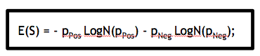
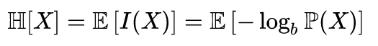
Don’t be afraid...
First let’s find a generalised form:
E(S) = - p_{Pos} LogN(p_{Pos}) - p_{Neg} LogN(p_{Neg});
I(X) ⬅ the quantity of information for content X

Slide 69
Don’t be afraid...
First let’s find a generalised form:
E(S) = - p_{Pos} LogN(p_{Pos}) - p_{Neg} LogN(p_{Neg});
Our hypothesis
In decision-tree learning
I(X) ⬅ the quantity of information for content X

Slide 70
Don’t be afraid...
First let’s find a generalised form:
E(S) = - p_{Pos} LogN(p_{Pos}) - p_{Neg} LogN(p_{Neg});
b is our Base (the set of natural numbers N, in our specific case)

Slide 71
Don’t be afraid...
First let’s find a generalised form:
E(S) = - p_{Pos} LogN(p_{Pos}) - p_{Neg} LogN(p_{Neg});
But hold on... Why the “Log” ????

Slide 72
Random Variables
We will spend the rest of the semester dealing with random variables
A random variable is a function defined on a particular sample space
For example, if we roll two dice there are 36 possible outcomes – this is the sample space
The sum of the two dice is the random variable

Slide 73
Random Variables
Let y1 and y2 represent the values of the two dice
Let x=y1+y2
x can take on any one of 11 values between 2 and 12, with some more common than others
The relative likelihood of rolling each of the possible sums is
2 | 3 | 4 | 5 | 6 | 7 | 8 | 9 | 10 | 11 | 12
1 | 2 | 3 | 4 | 5 | 6 | 5 | 4 | 3 | 2 | 1

Slide 74
Probability Distribution Function
We can calculate a probability from this table and plot the probability against the sum

Slide 75
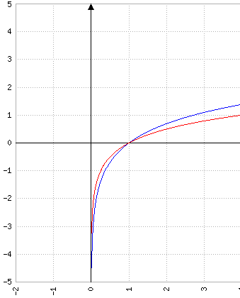
Log-N Distribution
Why Log?
Because in a probability density, the quantity of information for a content X is higher, the less probable is X in a certain source of information;
If X is certain, then I(X) = 0;
The more “unexpected” is X, the higher the quantity of information I(X);

Slide 76
Enough with the digression!
Where were we?

Slide 77
How does decision-tree learning actually take place?
Suppose the following algorithm:
A ← “best” decision attribute for next node in decTree;
<<decTree>>
A

Slide 78
Along comes a spider...
Best ➔ the Attribute which discriminates the most across all the available information;

Slide 79
Along comes a spider...
Best ➔ the Attribute which discriminates the most across all the available information;
Entropy!

Slide 80
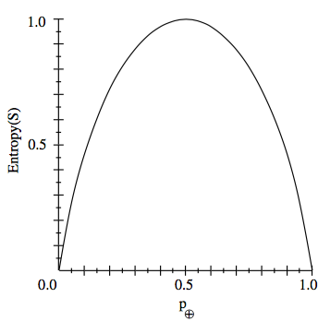

Entropy in ML
Entropy measures the “impurity” of the dataset;
Say What?
Notes:
https://en.wikipedia.org/wiki/Self-information
https://en.wikipedia.org/wiki/Entropy_(information_theory)

Slide 81
Entropy in ML
Entropy measures the “impurity” of the dataset;
the “unbalance” of positives & negatives w.r.t., a certain attribute;
So...

Slide 82
Information Gain
Why not using Entropy to evaluate the information gain of choosing a certain A w.r.t., another?
Gain(S,A) == expected reduction in entropy after sorting S w.r.t., A

Slide 83
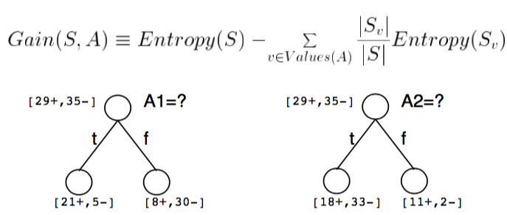
Gain(S,A)

Slide 84
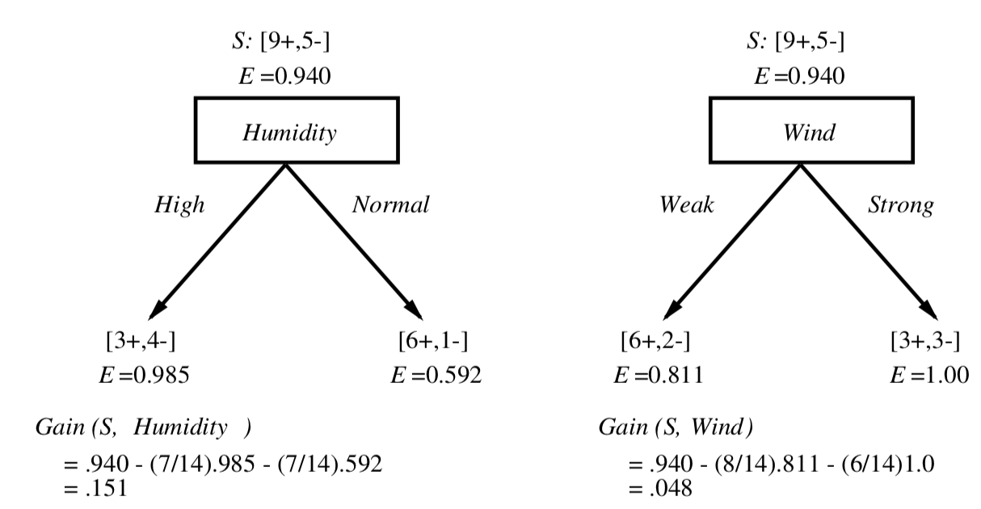
Back to our example...
Which attribute is the best classifier in scenario X?

Slide 85
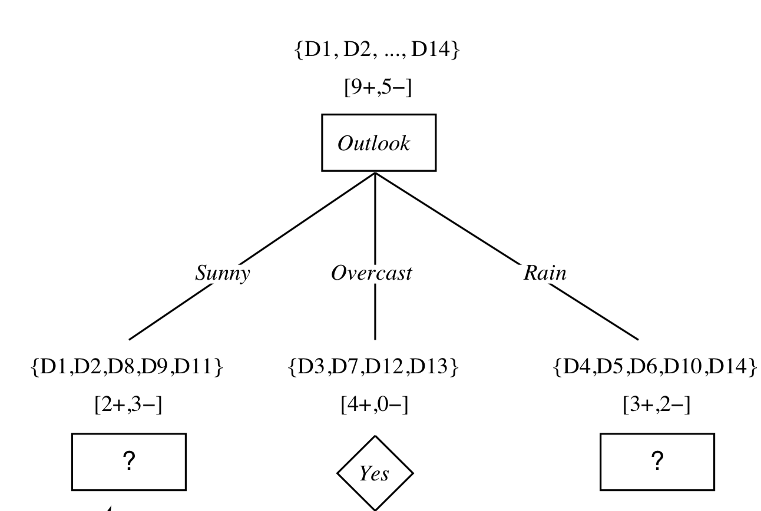
Back to our example... (cont’d)

Slide 86
Back to our example... (cont’d)
Which attribute is the best classifier here?

Slide 87
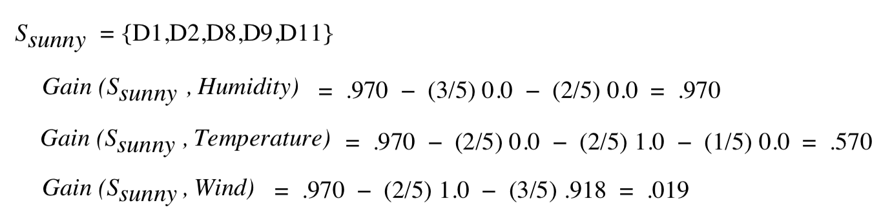
Simple!
Compute information gain:

Slide 88
Simple!
Compute information gain:

Slide 89
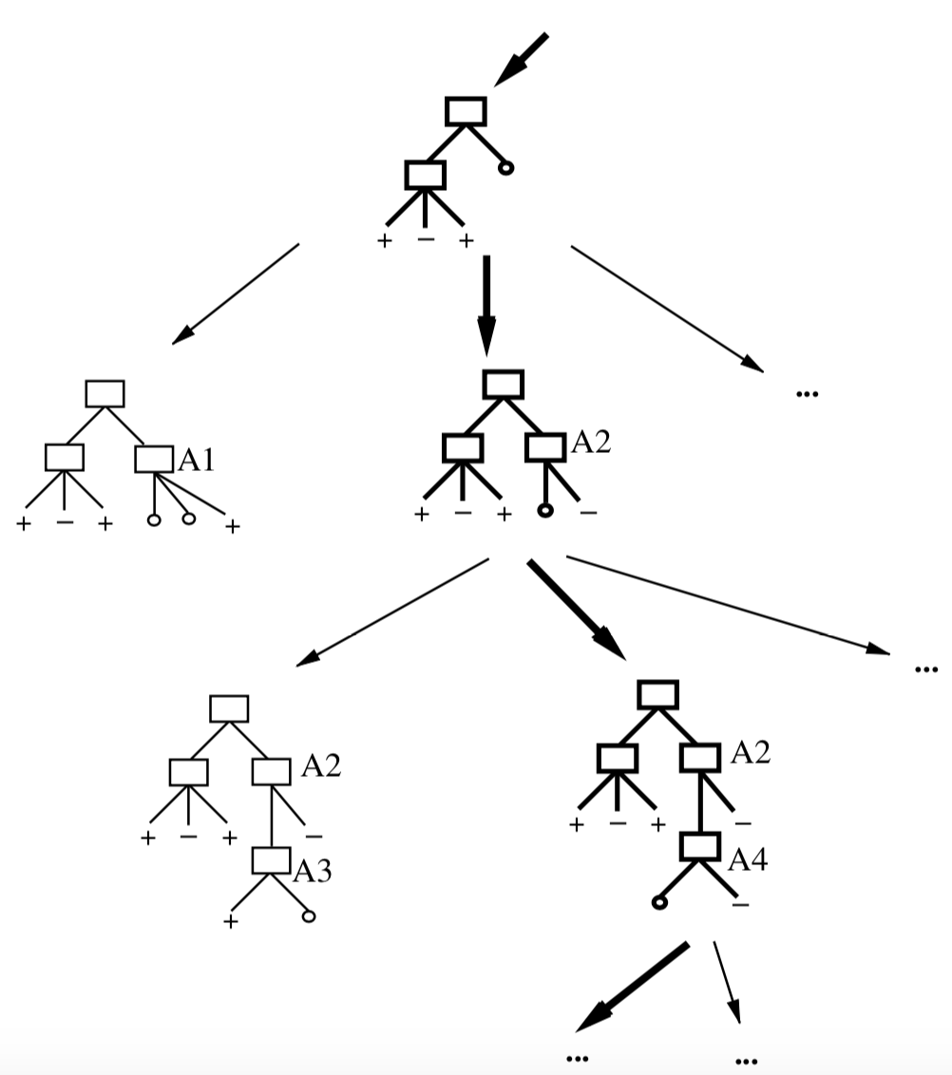
Iterate the above until hypotheses space is exhausted!
Meet the hypotheses space search algorithm called ID3!

Slide 90
Iterate the above until hypotheses space is exhausted!
ID3 – Itertive Dichotomiser 3
Based on info-gain;
C4.5 algorithm is its spawn;
Uses + or – to infer;
Notes:
https://en.wikipedia.org/wiki/ID3_algorithm

Slide 91
ID3, features & assumptions
Strong Assumption: Hypotheses Space is complete
Target function surely is there;
Outputs a single hypothesis (hardcoded in the leaves);
Statistically-based robustness;
Impervious to noisy data, as long as space is complete;

Slide 92
ID3, features & assumptions
Strong Assumption: Hypotheses Space is complete
Target function surely is there;
Outputs a single hypothesis (hardcoded in the leaves);
Statistically-based robustness;
Impervious to noisy data, as long as space is complete;
Major drawback!
Can’t play 20 questions!

Slide 93
Back to our inductive bias assumption
Inductive Bias in ID3:
A shortest decision-tree is “always” preferred!
This means that the algorithm prefers what “generalises” faster;
Shortest-trees will in fact have highest information-gain highest in the tree towards the root node;

Slide 94
Inductive Bias: ID3
++++
+++
Information
Gain!
+
-
---
-----
Notes:
Gini index

Slide 95
Note on Inductive Bias
Bias is a preference with respect to a class of hypotheses;
Bias is *not* a restriction of the hypotheses space;
ID3 and decision-tree learning follows rigorous deductive reasoning, why shortest tree is preferred?
++++
+++
Information
Gain!
+
-
---
-----

Slide 96

Note on Inductive Bias
Bias is a preference with respect to a class of hypotheses;
Bias is *not* a restriction of the hypotheses space;
ID3 and decision-tree learning follows rigorous deductive reasoning, why shortest tree is preferred?
++++
+++
Information
Gain!
+
-
---
Guess...
-----

Slide 97
Note on Inductive Bias
Bias is a preference with respect to a class of hypotheses;
Bias is *not* a restriction of the hypotheses space;
ID3 and decision-tree learning follows rigorous deductive reasoning, why shortest tree is preferred?
++++
+++
Information
Gain!
+
-
---
Occam’s Razor: Always prefer the shortest hypothesis that fits the data
-----

Slide 98
Occam’s Razor: Why/when does it make sense?
Occam’s Razor: Always prefer the shortest hypothesis that fits the data
First, a shorter hypothesis that fits *all* data is highly unlikely to be a coincidence;
Corollary: the longer the hypothesis the higher the chance of coincidentality;

Slide 99
Robustness and Noise in ID3
Rigorous deductive reasoning makes noise less likely to affect results, but...

Slide 100
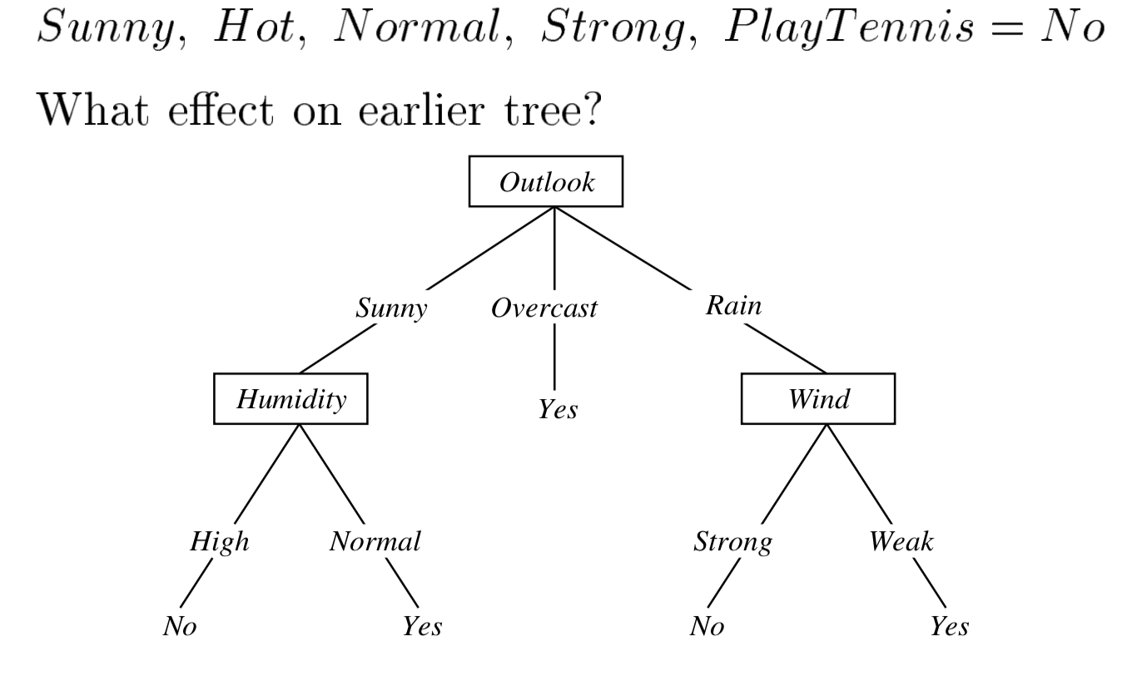
Robustness and Noise in ID3
Rigorous deductive reasoning makes noise less likely to affect results, but...
Consider adding a noisy sample in our example, as follows:

Slide 101
Robustness and Noise in ID3
What happens to our tree?

Slide 102
Robustness and Noise in ID3
What happens to our tree? Is Exposed to Overfitting!

Slide 103
Overfitting
What happens to our tree? Is Exposed to Overfitting!
Overfitting in this context means that ID3 “forces” decision-tree to “explain” “absurd” cases as well...

Slide 104
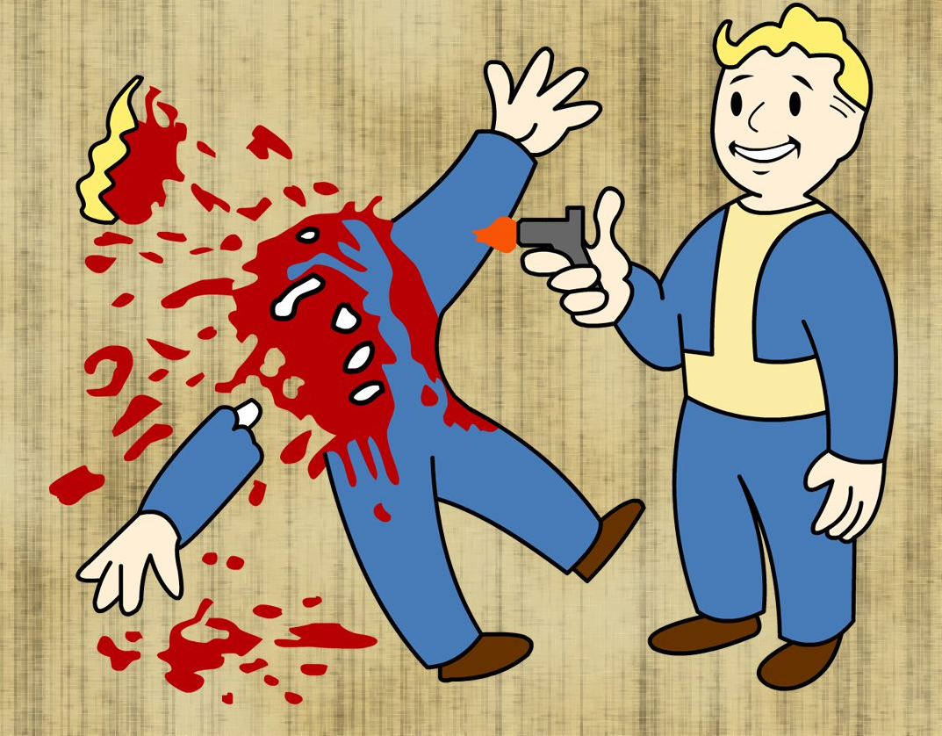
Overfitting
“Overfitting means shooting the mosquito with a gun”
Cit.
a friend of mine which shall remain nameless

Slide 105
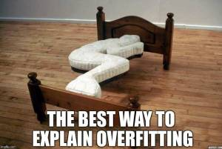
The best way to explain overfitting…
Notes:
https://gerardnico.com/data_mining/overfitting

Slide 106
Overfitting: Quotes from the trenches
«When your learner outputs a classifier that is 100% accurate on the training data but only 50% accurate on test data, when in fact it could have output one that is 75% accurate on both, it has overfit.»
Pedro Domingos – «A Few Useful Things to Know About Machine Learning», CACM 55(10), 2012

Slide 107
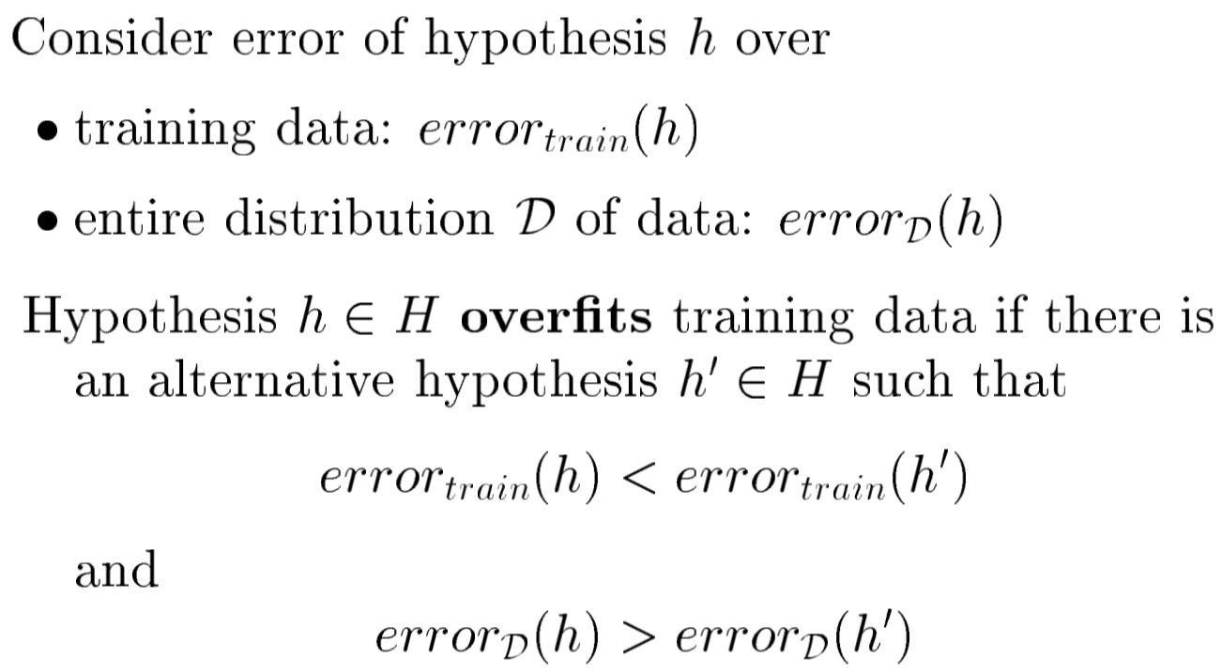
More Formally...

Slide 108
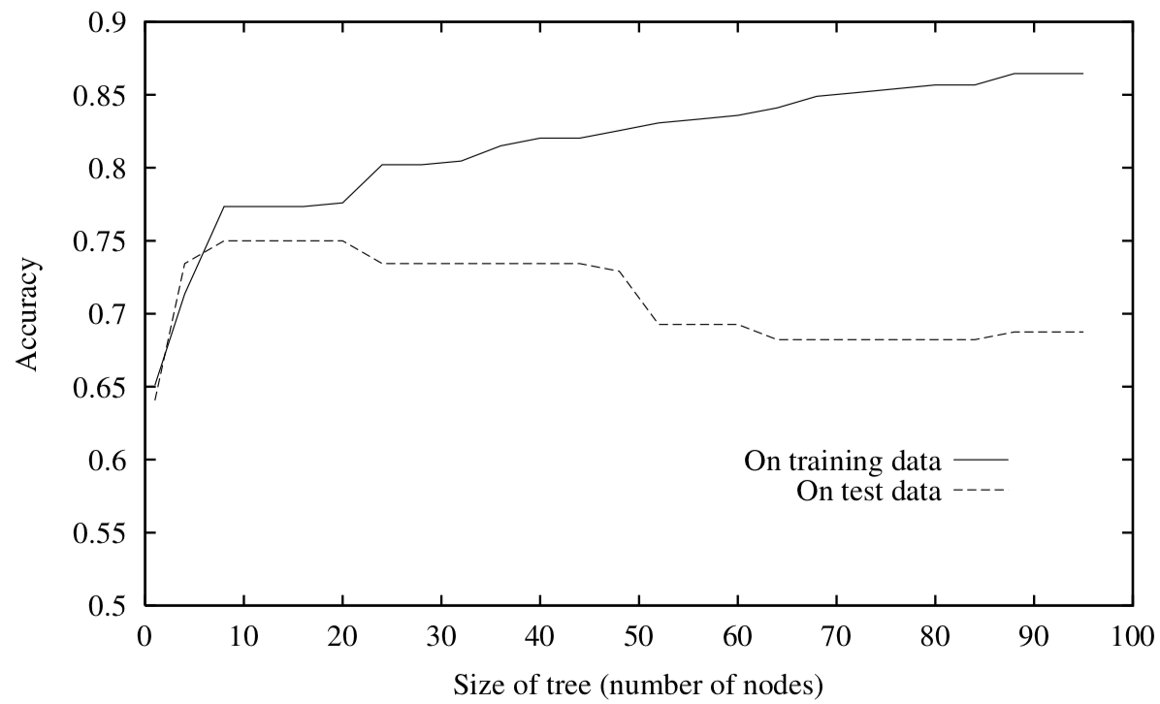
Overfitting in Decision-Tree Learning
Decision-Tree learning is robust w.r.t. noisy data, since a result is always obtainable, but is *very* sensible to overfitting

Slide 109
How do we avoid overfitting?

Slide 110
Stop growing when size of tree climbs...

Slide 111
Stop growing when size of tree climbs...

Slide 112
Stop growing when size of tree climbs...
Probably not worth it to get here...

Slide 113
So, what can we do?
Grow full tree then prune;
Stop growing when leftover data-split is no longer statistically significant
Trick of the Side-data
Measure performance over training data
Measure again performance over separate data
Use MDL boosting!
Notes:
http://citeseerx.ist.psu.edu/viewdoc/download?doi=10.1.1.89.6556&rep=rep1&type=pdf
http://www.cs.cmu.edu/~guestrin/Class/10701-S05/slides/DTrees-MDL-Boosting-2-9-05.pdf

Slide 114
In essence...
Grow full tree then prune;
Stop growing when leftover data-split is no longer statistically significant
Trick of the Side-data
Measure performance over training data
Measure again performance over separate data
Use MDL boosting!
Notes:
http://citeseerx.ist.psu.edu/viewdoc/download?doi=10.1.1.89.6556&rep=rep1&type=pdf
http://www.cs.cmu.edu/~guestrin/Class/10701-S05/slides/DTrees-MDL-Boosting-2-9-05.pdf

Slide 115
Boosting in ML
boosting techniques are machine-learning meta-algorithms, e.g.,:
Majority vote;
Adaptive tech;
…
Used primarily to reduce bias or the effect of variance;

Slide 116
Minimum Description Length (MDL)
Min(S_{T} + S_{miss(T)})
Size of the tree
Size of the misclassification tree
MDL operates a trade-off between tree-size and training error;
Good choice for post-training improvement;
Notes:
See more slides here: http://www.cs.cmu.edu/~guestrin/Class/10701-S05/

Slide 117
Alternative Boost: Reduced-Error Pruning
Algorithm Design Principles:
Prune(X) = removing the subtree at node X, make X a leaf and assign the most common class at X;
X is removed if the resulting tree performs no worse then the original on the validation set*;
X is removed iteratively choosing the node whose removal most increases dec.-tree accuracy on graph;
* red. coincidences and errors ☺

Slide 118
MDL vs. Reduced-Error Pruning
Split data into training and validation set V_{s}
Repeat{
Evaluate pruning impact on V_{s};
[Greedy Rule] Remove node that most improves accuracy of V_{s};
}
Until further pruning is harmful;

Slide 119
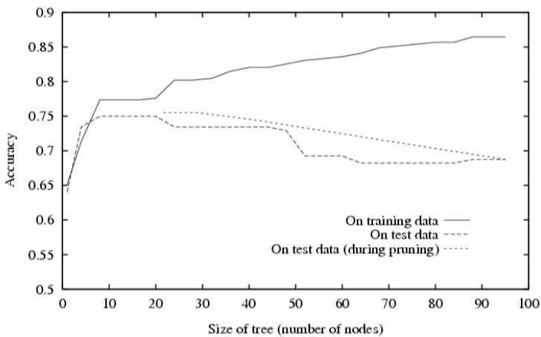
Reduced-Error Pruning

Slide 120
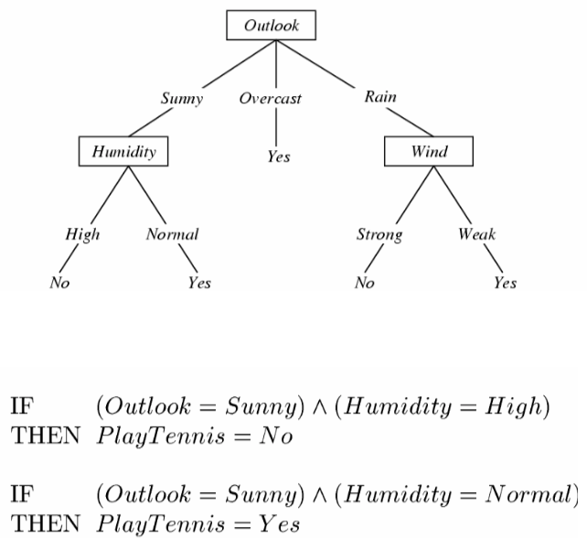
Finally... Extracting business rules from decision-trees
IF
<Conjunction-of-literals-in-decision-path>
THEN
<value-classification-in-the-leaf>

Slide 121
Finally... Extracting business rules from decision-trees
IF
<Conjunction-of-literals-in-decision-path>
THEN
<value-classification-in-the-leaf>

Slide 122
Finally... Extracting business rules from decision-trees
IF
<Conjunction-of-literals-in-decision-path>
THEN
<value-classification-in-the-leaf>

Slide 123
When do we use Decision-Trees?
Essentially every time a YES/NO answer is viable;
Obviously, target function needs to be discrete...
Can you imagine an infinite-leafed decision-tree?

Slide 124
What did you learn today?
How does decision-tree learning work?
Incremental predilection of information gain maximization
When should I use it?
When disjunctive hypotheses are viable
How can I avoid its limitations?
Use boosting!
Control overfitting!
Where are the business rules that DT extracts?
IF-THEN-ELSE statements following paths that DT models

Slide 125

Questions?
Aaaanndd...
That’s it!

Slide 126
Required Reading
T. Mitchell Book, Chapt. 3
Until “Boosting” (excluded)
Paper on MDL
http://citeseerx.ist.psu.edu/viewdoc/download?doi=10.1.1.89.6556&rep=rep1&type=pdf

